Slide 1
B2X 2차년도 3차 Pilot Study
Analysis of EEG data from the taVNS experiments
- N=20

Slide 2
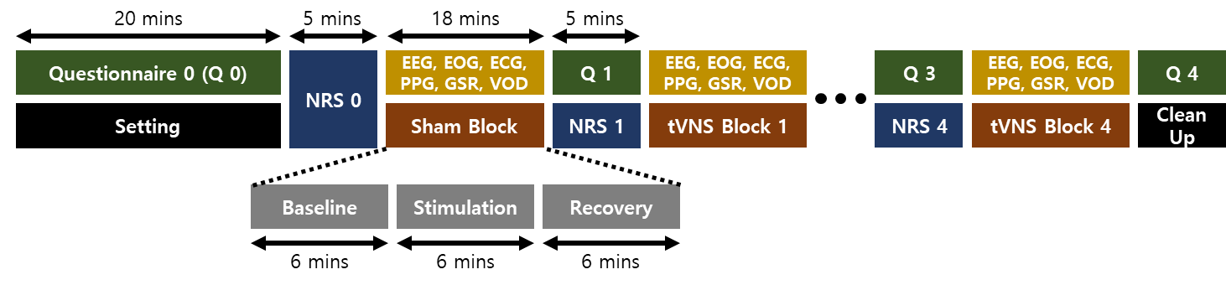
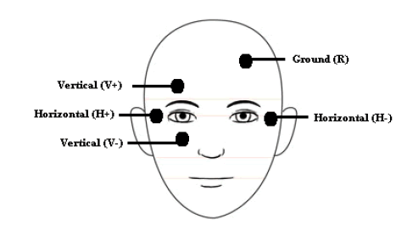
Experiment Protocol
BIOPAC 세팅
Sampling rate | 1000 Hz
ECG | Lead Ⅰ
PPG | 오른손 검지
GSR | 오른손 중지, 약지
VOD | 눈이 보이도록
Subject
Posture | Lying down
Eyes | Open
눈 ~ 태블릿 거리 | 50-100 cm
Frequency
20 Hz | 100 Hz
1 | 2
S020 | S100
N020 | N100
Fixed parameters
Electrode location | Left cymba concha
Pulse width | 200 us
Waveform | Biphasic symmetric | A
 | Biphasic | B

Slide 3
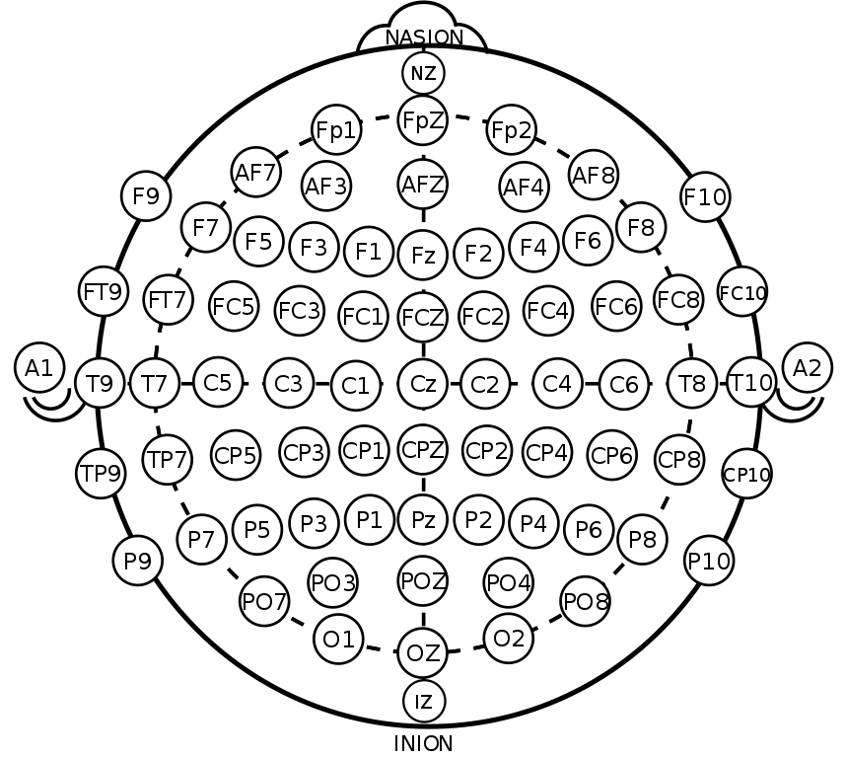
EEG Setting
0
Time
1 | 2 | 3 | 4 | 5 | 6 | 7 | 8
Empty | Fc5 | F7 | C3 | P3 | P7 | Cp5 | T7
9 | 10 | 11 | 12 | 13 | 14 | 15 | 16
F4 | Fc6 | F8 | C4 | P4 | P8 | Cp6 | T8
17 | 18 | 19 | 20 | 21 | 22 | 23 | 24
Pz | Poz | O1 | Oz | O2 | Fc1 | Fc2 | Cz
25 | 26 | 27 | 28 | 29 | 30 | 31 | 32
Cp1 | Cp2 | Fp1 | Fpz | Fp2 | Fz | A1 | F3
GND
REF
EEG 세팅
Sampling rate | 512 Hz
Gain | 239
33 | Reference | Gnd
flag | A2 | Afz

Slide 4
Acq2mat for EOG
https://github.com/bccummings/acq-tools.git
B2X_acq2mat
modifying acq2mat.py
Load mat file
- load(filename)
[세팅 과정]
Anaconda 가상환경 ‘acq2mat’
conda create –n acq2mat
conda install pip
pip install bioread
pip install numpy
pip install pandas
pip install scipy
conda install jupyter
pip install natsort
pip install tqdm
cd E:\B2X\2차년도\03_pilot\CODE\python

Slide 5
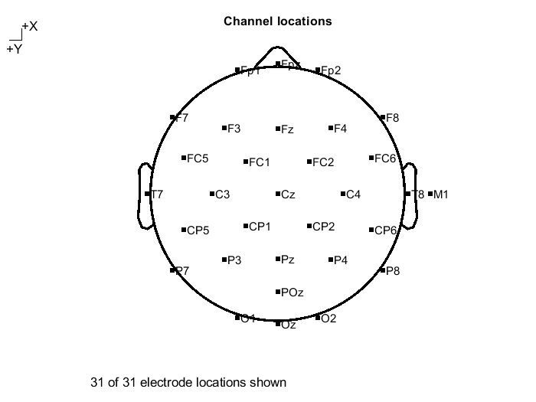
Framework of Analysis
Data Extraction
- Acquire 34ch cdf files (ch1: time, ch2: noise, ch34: flag)
cdf → txt: manually using telescan
txt → mat: python programming (ch1, ch2, ch34 are removed)
Result: .mat files that contain 31ch EEG data
2. .locs file preparation
Based on 10-20 system
32 ch
3. mat2set
Convert mat file to set file
4. Filtering
0.5Hz HPF
100Hz LPF
60Hz BRF

Slide 6
Framework of Analysis
5. Session dividing
session: base(6min), stim(6min), reco(6min)
Session dividing을 하지 않고 ICA를 하면, stim 구간의 노이즈가 반영되어 정확한 eye-artifact를 제거할 수 없음
Session 별로 eye-artifact를 제거하기 위해 session을 나누어 줌
6. Eye-blinking removal
참고: EEGLAB ICA and EOG

